Slide 1
CO-ATTENTION MODEL For visual question answering
PROJECT MEMBERS:
VAGUL MM -2014103081
PRINCE MELVIN A-2014103596
JEGATHEESWARAN M-2014103583
GUIDE:
Dr. SUDHA S
Assistant Professor

Slide 2
ABSTRACT
Our project focuses on VQA: Visual Question Answering, specifically, answering questions about a given image. We present a novel co-attention model for VQA that jointly reasons about image and question attention.
VQA is the task that for given text-based questions about an image, and the system needs to infer the answer for each Question.
VQA has many potential real-world applications, among which one of the most valuable is to assist visually impaired individuals in understanding contents of images from the web.
Moreover, VQA could be a great system to use in the Visual Turing Test or other computer vision tasks to evaluate the system’s ability when comparing with human performance.

Slide 3
Introduction
PROBLEM STATEMENT
Answering questions about a given image with image attention based on question.
Specifically, not only are we focusing on which region in the image we should look at, but which word in the sentence is of interest.
PROJECT DOMAIN
Computer Vision : Computers can be made for gaining high-level understanding from digital images
Image Processing: to extract objects and infer context from images.
Natural Language Processing to use POS tagging of Questions

Slide 4
Overall OBJECTIVE
We add image-question co-attention to exploit multi-modal relationship between pixels and words, which successfully boosts accuracy.
We build Multi- Layer Perceptron (MLP) model with question-grouped training and softmax loss. Word2Vec embeddings and VGG net image features are used.

Slide 5
Literature survey

Slide 6
Paper Title and Authors | Concepts Discussed | Inference
1. “An Analysis of Visual Question Answering Algorithms”, Kushal Kafle, Christopher Kanan | Analyze the performance of both baseline and state-of-the-art VQA models, including multi-modal compact bilinear pooling (MCB), neural module networks, and recurrent answering units. | Establish how attention helps certain categories more than others, determine which models work better than others
2. “Hierarchical Question-Image Co-Attention for Visual Question Answering”, Jiasen Lu, Jianwei Yang, Dhruv Batray , Devi Parikhy | In this paper,in addition to modeling “where to look” or visual attention, it is equally important to model “what words to listen to” or question attention. | The model improves the state-of-the-art on the VQA dataset from 60.3% to 60.5%,using Coattention model

Slide 7
Paper Title and Authors | Concepts Discussed | Inference
3. “Deep learning evaluation using deep linguistic processing”, Alexander Kuhnle, Ann Copestake | Argue that artificial data can be used to address visual question answering as a complement to current practice. | With the help of existing ‘deep’ linguistic processing technology we are able to create challenging abstract datasets, which enable us to investigate the language understanding abilities in detail
4.“Visual7W: Grounded Question Answering in Images”, Yuke Zhuy, Oliver Grothz, Michael Bernsteiny, Li Fei-Fei | A semantic link between textual descriptions and image regions by object-level Grounding | Enables a new type of QA with visual answers, in addition to textual answers used.We study the visual QA tasks in a grounded setting with a large collection of 7W multiple-choice QA pairs

Slide 8
Paper Title and Authors | Concepts Discussed | Inference
5.“Simple Baseline for Visual Question Answering”, Bolei Zhou, Yuandong Tian, Sainbayar Sukhbaatar, Arthur Szlam, and Rob Fergus | Described a very simple bag-of-words baseline for visual question answering. This baseline concatenates the word features from the question and CNN features from the image to predict the answer | Evaluated on the challenging VQA Dataset, it shows comparable performance to many recent approaches using recurrent neural networks
6. “Deep Residual Learning for Image Recognition”, Kaiming He, Xiangyu Zhang, Shaoqing Ren, Jian Sun | A residual learning framework to ease the training of networks that are substantially deeper than those used previously. | Explicitly reformulate the layers as learning residual functions with reference to the layer inputs, instead of learning unreferenced functions

Slide 9
Paper Title and Authors | Concepts Discussed | Inference
7. “GloVe: Global Vectors forWord Representation” , Jeffrey Pennington, Richard Socher, Christopher D. Manning | A new global log-bilinear regression model that combines the advantages of the two major model families in the literature: global matrix factorization and local context window methods. | model efficiently leverages statistical information by training only on the nonzero elements in a word-word co-occurrence matrix, rather than on the entire sparse matrix or on individual context windows in a large corpus.
8. “Deep Compositional Question Answering with Neural Module Networks” Jacob Andreas, Marcus Rohrbach, Trevor Darrell, Dan Klein | Describe a procedure for constructing and learning neural module networks, which compose collections of jointly-trained neural “modules” into deep networks for question answering. | Decomposes questions into their linguistic substructures, and uses these structures to dynamically instantiate modular networks

Slide 10
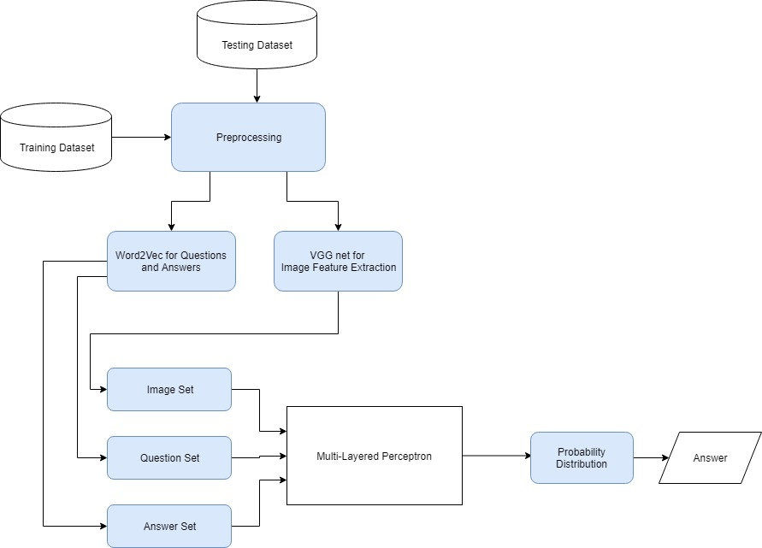
ARCHITECTURE DIAGRAM

Slide 11
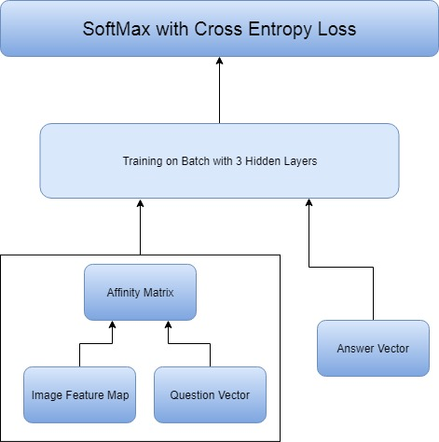
Architecture diagram-mlp

Slide 12
Proposed system
1.Preprocessing
2.Feature Extraction
2.1 Word2Vec Embeddings
2.2 Image Feature Extraction
3.Co-Attention Model
3.1 Affinity Matrix
3.2 Attention Vector
3.3 Weighted Image and Question Map

Slide 13
4. Score Generation
4.1 Image-Question-Answer pair
4.2 Activation
Overall Input:
Image and related question
Overall Output:
Score to the correct image-question-answer pair

Slide 14
Modules Split up
There are four Modules:
Preprocessing
Feature Extraction
Co-Attention Model
Score Generation

Slide 15
Modules Explanation
1.Preprocessing
Input: Raw dataset with images , questions and answers
Output: Modified dataset with image path,question id,question and answers
We evaluate our proposed model on Visual7W Telling dataset . This dataset includes 69817 training questions, 28020 validation questions, and 42031 test questions. Each question starts with one of the six W s, what, where, when, who, why and how, and has four answer choices. The three wrong answers are human-generated on a per-question basis. And the performance is measured by the percentage of correctly answered questions.

Slide 16
2. Feature Extraction
Input: Images , Questions and Answers
Output: Image Features and Vector representation for questions and answers
2.1 Word2Vec Embeddings
Questions and answers are represented as Bag of Words and converted to vectors using Word2Vec Embeddings.
2.2 Image Feature Extraction
We present a cnn to ease the training of networks that are substantially deeper than those used previously.
Image Features are represented using the VGG net

Slide 17
3.Co-Attention Model
Input : Image features, Question Vectors and correct answer score.
Output : Weighted image and question map.
We propose a novel mechanism that jointly reasons about visual attention and question attention, which we refer to as co-attention. Unlike previous works, which only focus on visual attention, our model has a natural symmetry between the image and question, in the sense that the image representation is used to guide the question attention and the question representation(s) are used to guide image attention. question-image co-attention terms are being incorporated into our model to represent the relationships between image and question. Specifically, in the image we would decide “Where to look at” using the spatial attention terms, and as for the questions, we will have a sense of “What are we asking” in order to choose informative words within the sentence.

Slide 18
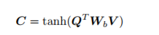
3.1 Affinity Matrix
Parallel co-attention attends to the image and question simultaneously. We connect the image and question by calculating the similarity between image and question features at all pairs of image-locations and question-locations. Specifically, given an image feature map V ∈ Rd×N , and the question representation Q ∈ Rd×T , the affinity matrix C ∈ RT ×N is calculated by
where Wb ∈ Rd×d contains the weights.

Slide 19
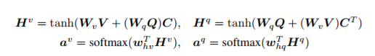
3.2 Attention Vector
We will train the attention vector of image feature av and the attention vector of question feature aq using an one-hidden layer neural network a v [n] = maxi(Ci,n) and a q [t] = maxj (Ct,j ). Instead of choosing the max activation, we find that performance is improved if we consider this affinity matrix as a feature and learn to predict image and question attention maps via the following
where Wv,Wq ∈ Rk×d , whv, whq ∈ Rk are the weight parameters. a v ∈ RN and a q ∈ RT are the attention probabilities of each image region vn and word qt respectively. The affinity matrix C transforms question attention space to image attention space

Slide 20
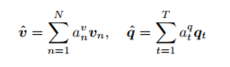
3.3 Weighted Image and Question Map
We compute the weighted image feature and question feature as:
After that, the new weighted feature ^v and ^q are concatenated with the original answers. Once the weighted image and question feature are obtained we can concentrate on the parts of the image based on the questions asked. So when a question is asked , the relationship between the question and image is obtained using the co-attention model and the specific part of the image is concentrated.

Slide 21
4. Score Generation
Input: Image , question and answer pair
Output: Score generated for correct answer.
4.1.Image-Question-Answer Pair
MLP model takes image-question-answer triplet as input, and outputs the probability of this triplet being true. Both questions and answers are represented as Bag-Of-Word features of pre-trained word2vec embeddings . Images are represented as the penultimate layer feature of VGG net.These features are concatenated and fed into an MLP model with one hidden layer

Slide 22
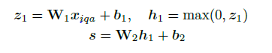
4.2.Activation Function
Softmax is done over the output scores of all four answers. Softmax with cross-entropy loss is demonstrated to train better and converge more quickly in our experiments . Formally, we denote image, question and answer as xi; xq; xa respectively, and the concatenated feature as xiqa = xixqxa, where is the concatenation operator. Each image-question-answer triple goes through the following MLP:

Slide 23
Tools used
Word2Vec Embedings
VGG net
Keras
Tensorflow(Backend)

Slide 24
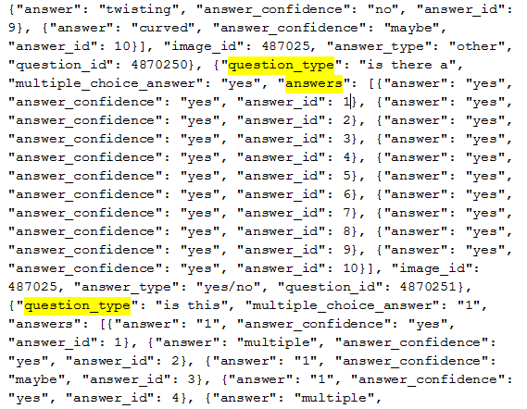
DATASET

Slide 25
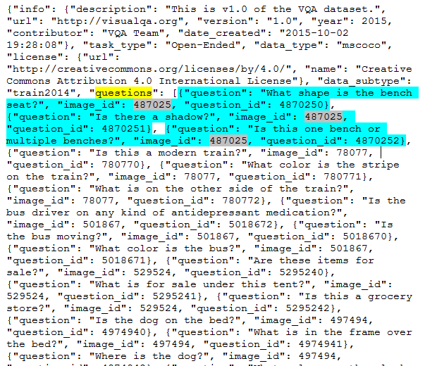
Dataset

Slide 26
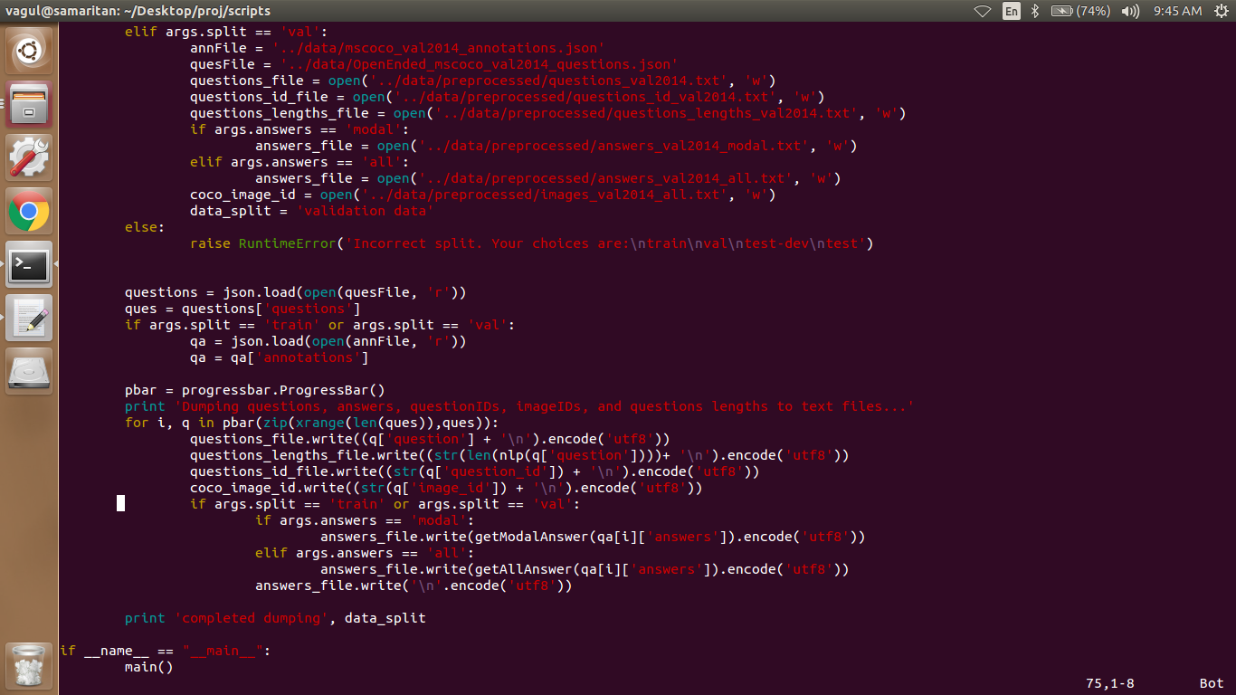
PREPROCESSING

Slide 27
Steps Performed
From the Annotations dataset, we take the image path, question id, answer and from dataset, we take the answer and the question.
This is used as an intermediated dataset (As shown in screenshot)
Then
The Top answers are selected and questions are filtered based on the top answers.
Then the questions are represented as bag of words and a vocabulary of question words is created and enumerated. This enumerated set of vocabulary is used to encode the string questions into vectors.
The same is done for answer.
The results are shown as below.

Slide 28
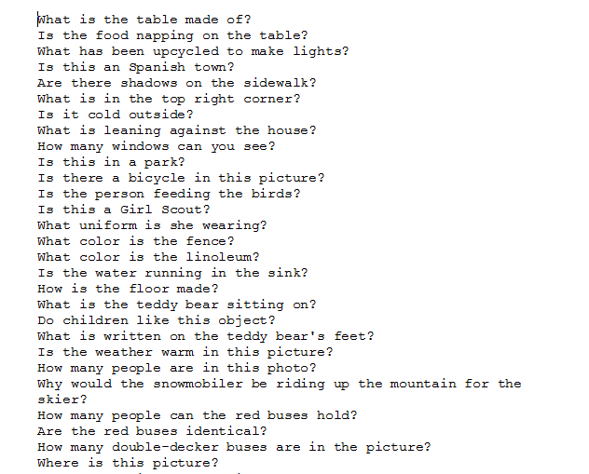
Intermediate result
Questions

Slide 29
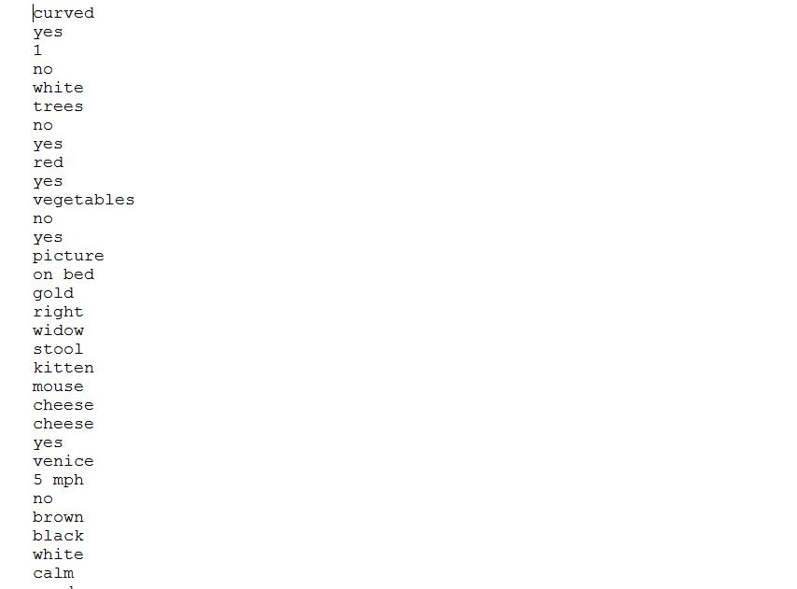
Answers

Slide 30
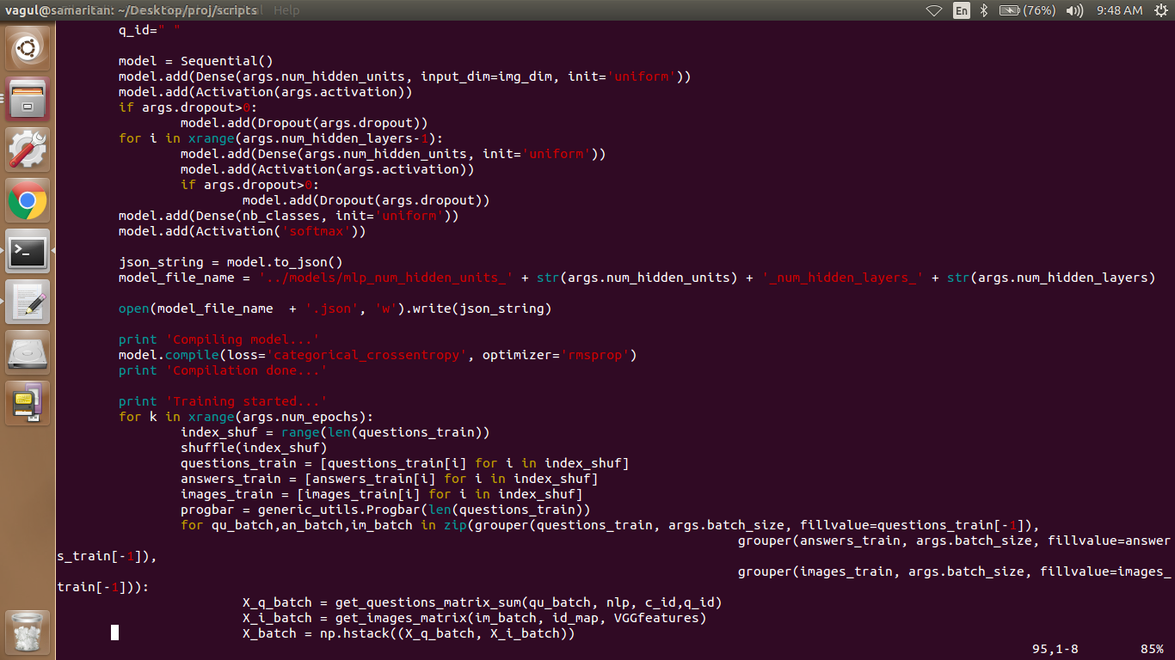
Implementation
Train MLP

Slide 31
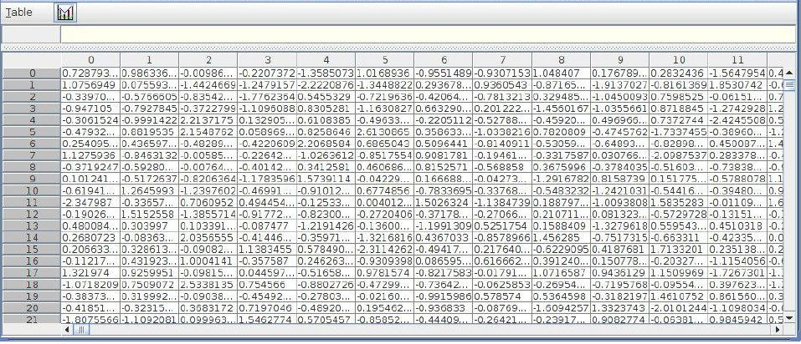
IMAGE features

Slide 32
Steps Performed
The above implemented code has a multi-layer perceptron with two hidden layers, 1024 hidden units in each layer and dropout layers in the middle for regularization.
The final layer is a softmax layer, and is responsible for generating the probability distribution over the set of possible answers.
We have used the categorical_crossentropy loss function since it is a multi-class classification problem.
The rmsprop method is used for optimzation.

Slide 33
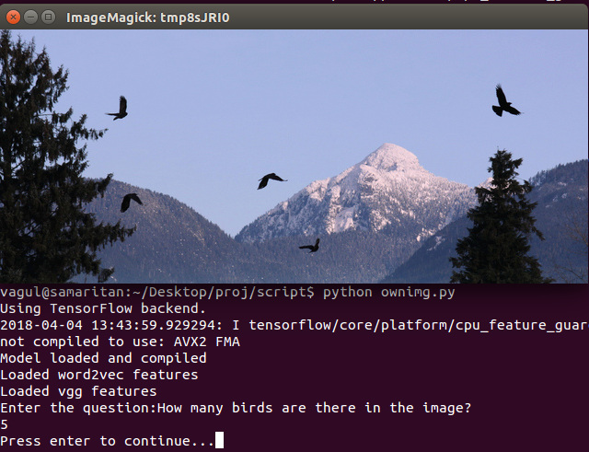
Test Cases
True Cases:
Case 1:

Slide 34
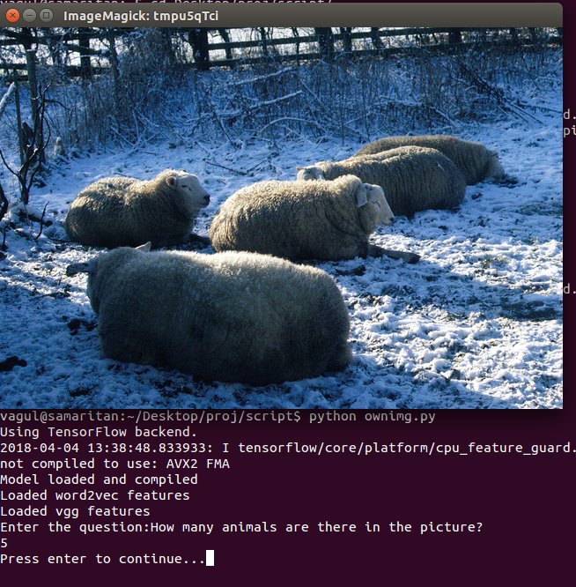
Case 2:

Slide 35
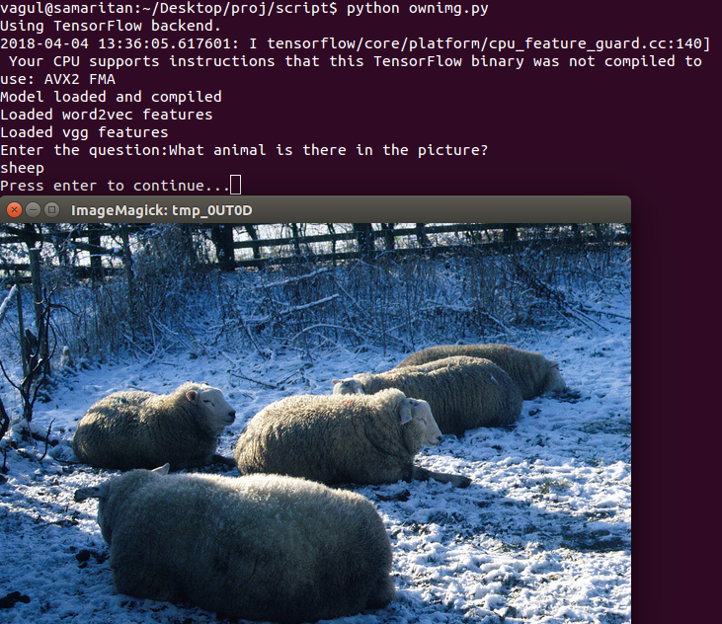
Case 3:

Slide 36
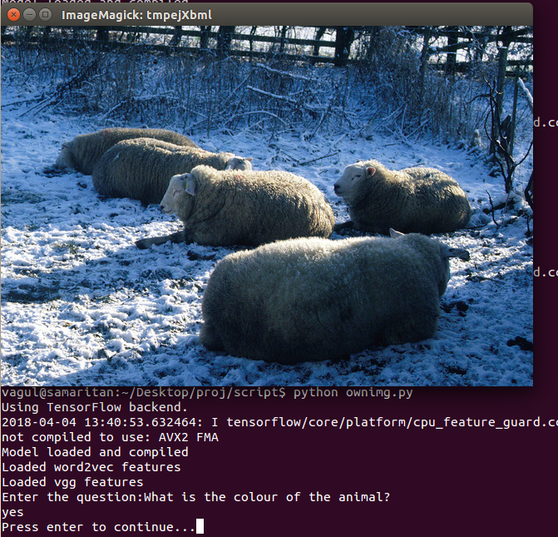
False Answer:

Slide 37
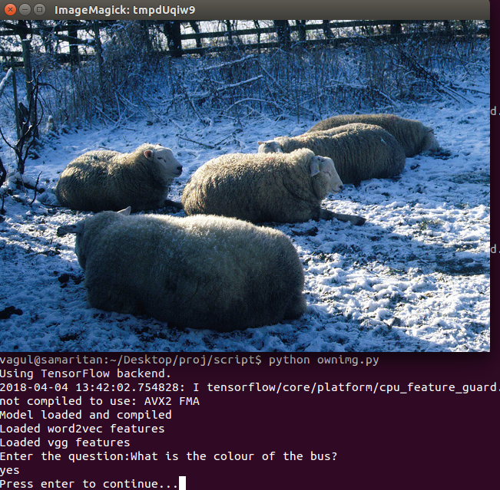
Absurd Cases:
Case 1:

Slide 38
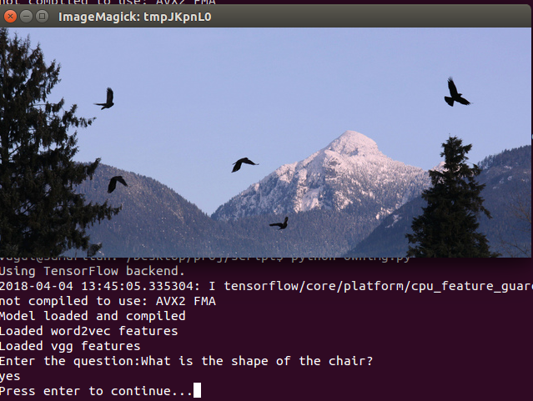
Case 2:

Slide 39
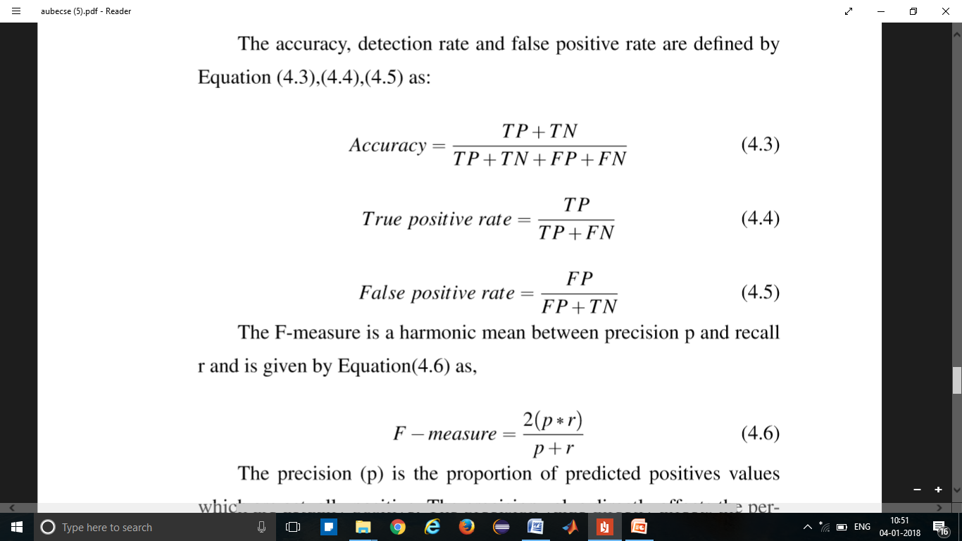
Evaluation Metrics
Performance of all the classiﬁers are evaluated by different measures like training accuracy, testing accuracy, confusion matrix, receiver operating characteristic curve(ROC), sensitivity, speciﬁcity, PRC, and F-score.
Confusion Matrix
Confusion matrix represents the values of TP, TN, FP, FN.

Slide 40
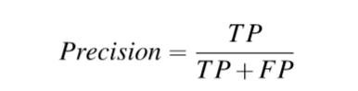
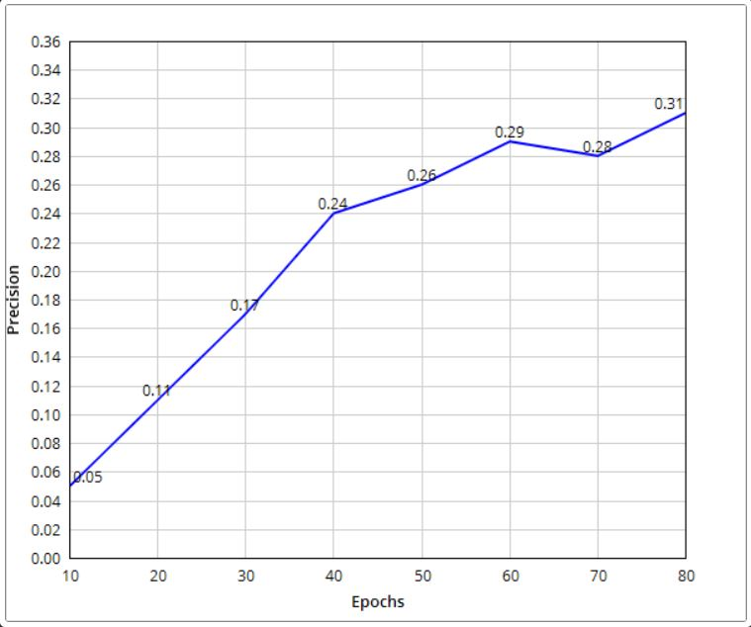
Precision:
The precision (p) is the proportion of predicted positives values which are actually positive. The precision value directly affects the performance of the system. A higher value of precision means a lower false positive rate and vice versa.

Slide 41
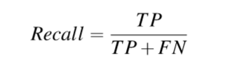
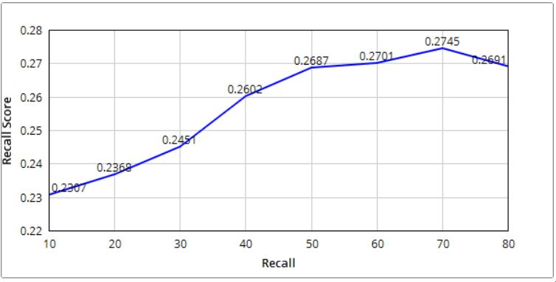
Recall:
The recall (r) is another important value for measuring the performance of the detection system and to indicate the proportion of the actual number of positives which are correctly identiﬁed.

Slide 42
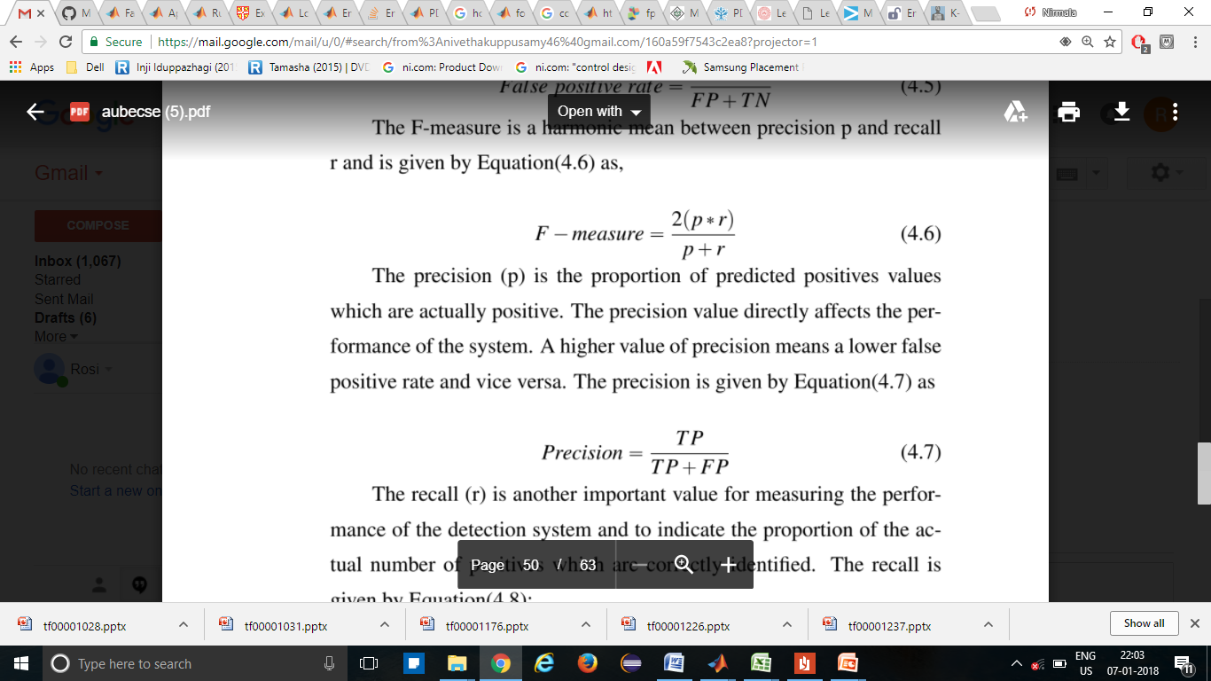
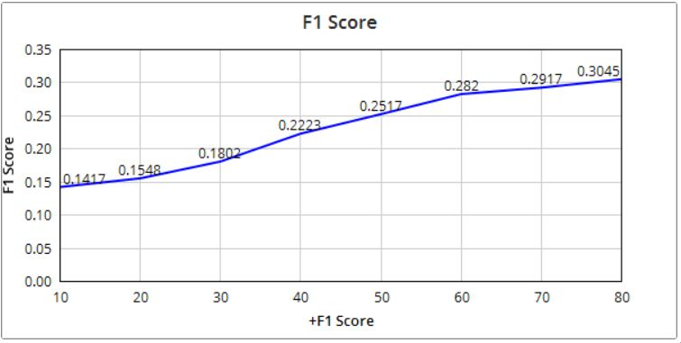
F-Measure
The F-measure is a harmonic mean between precision p and
recall r and is given by

Slide 43
REFERENCES
[1] K. Kafle and C. Kanan, “Visual question answering: Datasets, algorithms, and future challenges,”arXiv preprint arXiv:1610.01465, 2016.
[2] J. Lu, J. Yang, D. Batra, and D. Parikh, “Hierarchical question-image co-attention for visual question answering,” in Advances In Neural Information Processing Systems, pp. 289–297,2016.
[3] R. Szeliski, Computer vision: algorithms and applications. Springer Science & Business Media, 2010.
[4] V. Lopez, V. Uren, M. Sabou, and E. Motta, “Is question answering fit for the semantic web?:a survey,” Semantic Web, vol. 2, no. 2, pp. 125–155, 2011.
[5] D. Geman, S. Geman, N. Hallonquist, and L. Younes, “Visual turing test for computer vision systems,” Proceedings of the National Academy of Sciences, vol. 112, no. 12, pp. 3618–3623,2015.
[6] A. Jabri, A. Joulin, and L. van der Maaten, “Revisiting visual question answering baselines,”in European Conference on Computer Vision, pp. 727–739, Springer, 2016.
[7] Y. Zhu, O. Groth, M. Bernstein, and L. Fei-Fei, “Visual7W: Grounded Question Answering in Images,” in IEEE Conference on Computer Vision and Pattern Recognition, 2016.
[8] B. Zhou, Y. Tian, S. Sukhbaatar, A. Szlam, and R. Fergus, “Simple baseline for visual question answering,” arXiv preprint arXiv:1512.02167, 2015.
[9] K. He, X. Zhang, S. Ren, and J. Sun, “Deep residual learning for image recognition,” in Proceedingsof the IEEE Conference on Computer Vision and Pattern Recognition, pp. 770–778,2016.

Slide 44
THANK YOU

